Slide 1
IMATATION FOR REWARD SCIENCE
CAMOUFLAGE
BY CHRISTINE RABACAL
GRADE 7 MR. DE BEER

Slide 2
Outline:
What is camouflage and the different types of camouflage?
Camouflage in Frogs
Camouflage in Reptiles
Camouflage in Birds
Camouflage in Fish
Camouflage in Mammals
Camouflage in Insects, and other arthropods

Slide 3
What is camouflage?
Dictionary definition: To conceal something/someone with the use of disguise or protective colouring or clothing that blends into the surroundings.
Camouflage is classified into two groups: crypsis and mimesis.
Crypsis: Trying to make animals/objects hard to see.
Mimesis: To disguise something as something else.
Most things aim for crypsis.

Slide 4
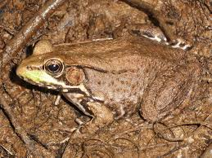
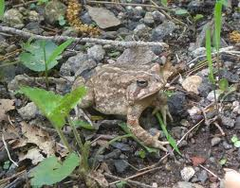
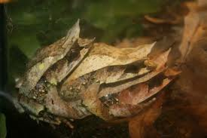
CAMOUFLAGE IN FROGS
UNUSUAL EXAMPLES:
Green tree frog
Bronze frog
Bullfrog
Asian leaf frog

Slide 5
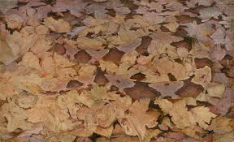
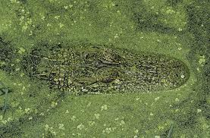
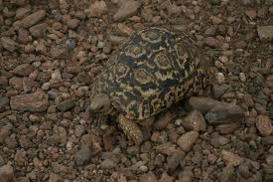
CAMOUFLAGE IN REPTILES
UNUSUAL EXAMPLES:
Chameleon
Snake
Crocodile
Tortoise

Slide 6
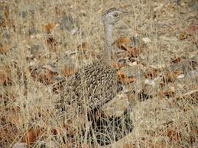
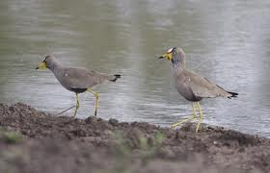
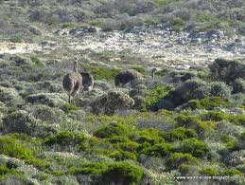
Camouflage in birds
UNUSUAL EXAPLES:
Owls
Franklins
Egyptian geese
Ostriches

Slide 7
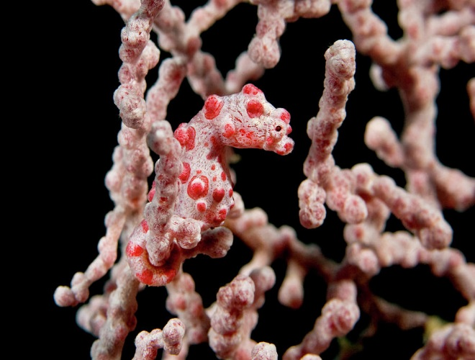
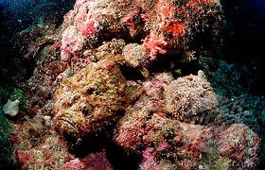
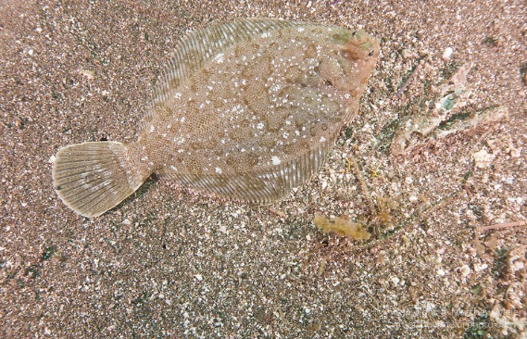
CAMOUFLAGE IN FISH
UNUSUAL EXAMPLES:
Sea horse
Octopus
Stone fish
Sole fish

Slide 8
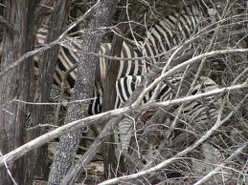
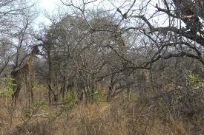
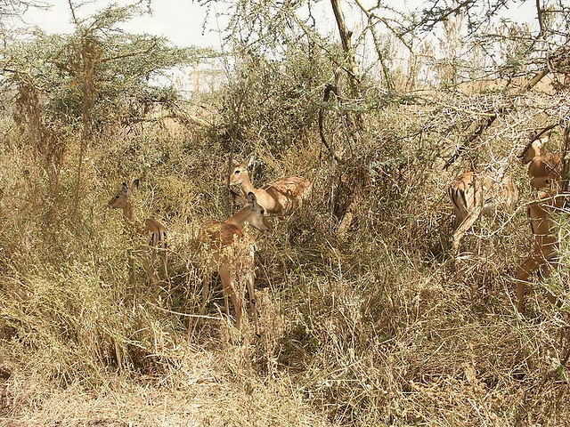
CAMOUFLAGE IN mammals
UNUSUAL EXAMPLES:
Leopard
Zebra
Giraffe
Impala

Slide 9
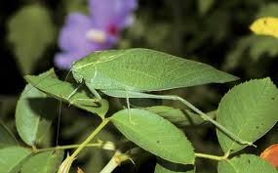
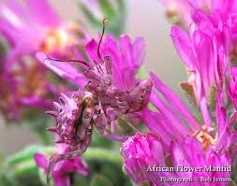
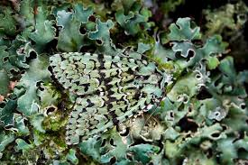
CAMOUFLAGE IN INSECTS
UNUSUAL EXAMPLES:
Stick insect
Grasshopper
Flower mantid
Lichen moth

Slide 10
bibliography
Google search – what is camouflage?
Google search – what frogs use camouflage?
Google search – what insects use camouflage?
Google images (for all pictures on this slide show)

