Slide 1
Bird flu: h5n1 virus
By Christine Rabacal
Grade 7, f block
Mr de beer

Slide 2
Outline
The hosts of this virus, and where they can be found.
The method of transmission.
What does this virus look like?
The life cycle is like for this virus.
Where the life cycle can most easily be broken.
A progression of the disease caused by the virus.
The pertinent symptoms that are associated with infection by the virus.
The history of the virus. The initial discovery, the hunt for the vector, significant breakthroughs in controlling it.
The location (including the country of origin, climate and habitat) that the virus can be found in.
How this virus can be controlled. How does/did this (the control) affect the communities affected by the virus?
Bibliography

Slide 3
The hosts of this virus, and where they can be found.
Host:
Birds – mainly domestic
Most Common Locations:
China
Indonesia
Northern Africa

Slide 4
The method of transmission.
Close or direct contact with sick or dead infected birds

Slide 5
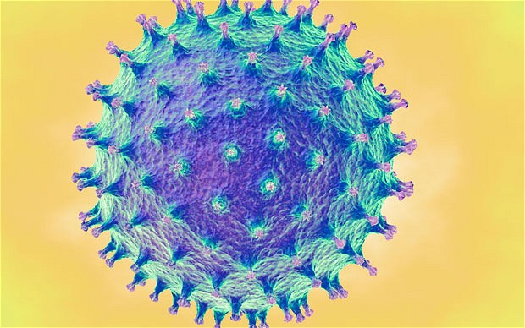
What does this virus look like?

Slide 6
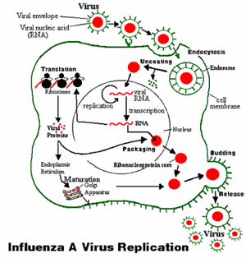
The life cycle for this virus.

Slide 7
Where the life cycle can most easily be broken.
The best way to control this is to vaccinate all of the birds and by taking extra precautions to avoid contamination when dealing with birds such as gloves, masks, etc.

Slide 8
A progression of the disease caused by the virus.
Starts with flu-like symptoms and then leads to:
High fever (+ 38 °C)
Diarrhoea, vomiting
Stomach ache
Bleeding for the nose and gums

Slide 9
The pertinent symptoms that are associated with infection by the virus.
Flu like symptoms:
Cough, fever, sore throat, sore muscles, nausea, diarrhoea.
It can be diagnosed by:
Taking a swab of nose or throat from the sick person, which is then sent to a lab for testing.

Slide 10
The history of the virus. the initial discovery, the hunt for the vector, significant breakthroughs in controlling it.
History:
Bird flu was first found in China in 1997, the strain was H5N1, which came from domestic geese.
Hunt for the vector:
The virus spread from main land China to South Asia and North Africa

Slide 11
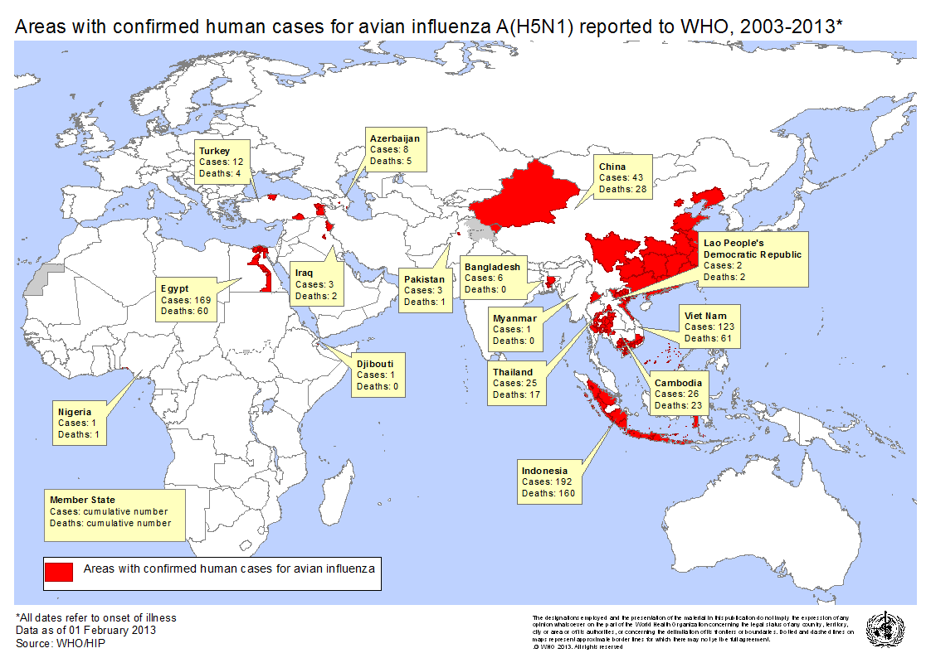
The location (including the country of origin, climate and habitat) that the virus can be found in.

Slide 12
How this virus can be controlled. How does/did this (the control) affect the communities affected by the virus?
This Virus Can Be Controlled By:
Vaccinating and/or Destroying All Of The Domestic Birds In The Area
The Effect of this control:
There was job losses and affected people by hunger and lack of protein, as well as mentally because millions of birds were dying.

Slide 13
Bibliography
http://www.cdc.gov/flu/avianflu/index.htm
http://gamapserver.who.int/mapLibrary/app/searchResults.aspx
http://www.telegraph.co.uk/health/healthnews/9030889/China-suffers-second-bird-flu-death-in-a-month.html
http://www.nejm.org/doi/full/10.1056/NEJMra052211
http://www.dailykos.com/story/2009/04/26/724740/-Influenza-primer-Human-Avian-Sea-Mammal-and-of-course-SWINE#
http://gamapserver.who.int/mapLibrary/Files/Maps/2003_AvianInfluenza_GlobalMap_01Feb13.png
http://www.who.int/influenza/human_animal_interface/en/

